Slide 1
315 Chapter One concepts

Slide 2
Systems Development Life Cycle (SDLC)
SDLC is the overall process of developing information systems through a multi-step process.
There are many (known) software development methodologies.
Four fundamental phases in SDLC:
Planning
Analysis
Design
Implementation

Slide 3
Systems Development Life Cycle

Slide 4
Processes and Deliverables
Process
Product
Project Plan
System Proposal
System
Specification
New System and
Maintenance Plan
Planning
Analysis
Design
Implementation

Slide 5
Systems Development Methodologies
A methodology is a formalized approach to implementing the SDLC
Well-known methodologies include
Waterfall development
Parallel development
System Prototyping
Throwaway Prototyping
Extreme Programming
Rational Unified Process (RUP)

Slide 6
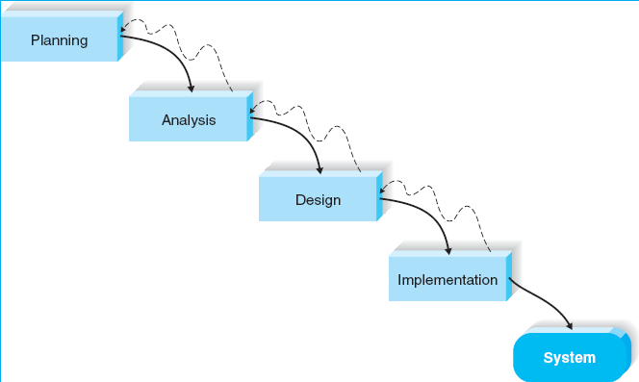
Waterfall Development

Slide 7
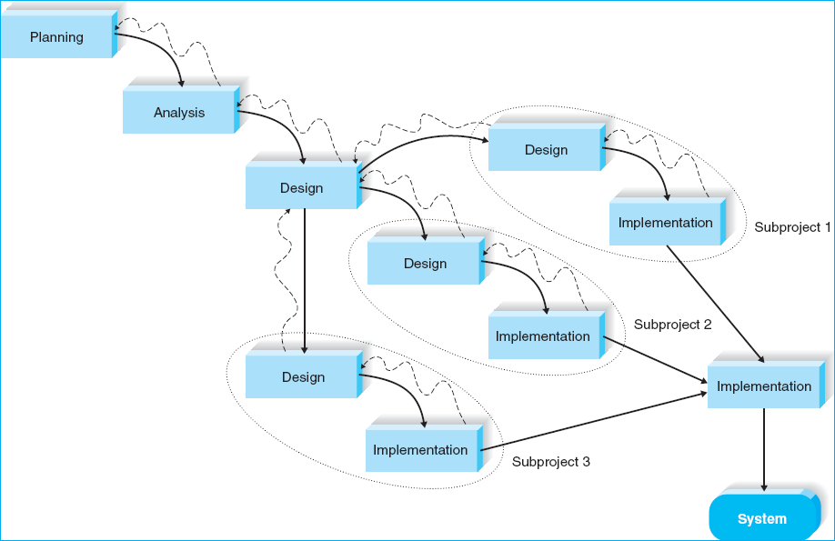
Parallel Development

Slide 8
Phased Development
Breaks an overall system into a series of versions and develops them sequentially.
The most important & fundamental requirements are included in the 1st version, then design and implement it.
After version 1 is implemented, work (analysis – design – implementation) begins on version 2.
Advantages:
Quickly delivering a useful system to users (compared with Waterfall or Parallel methodologies)
Because users work with the system sooner, they are more likely to identify additional important requirements sooner.
Disadvantages:
Users begin to work with an incomplete system.

Slide 9
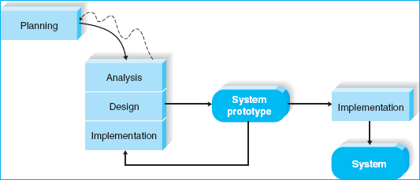
System Prototyping

Slide 10
Throwaway Prototyping
Also has a prototype, called design prototype.
The design prototype is used to get requirements and interact with the project team.
It will be throwaway because the prototype is only a mock-up not a high quality real system. In Web development we call it “wireframes”.
Advantages:
Allow to refine key issues before a system is built and produce more reliable system.
Disadvantages:
May take longer to deliver the final system as compared to prototyping-based methodology.

Slide 11
Extreme Programming
Based on four core values: communication, simplicity, feedback, and courage.
Analysis, design, and implementation phases are performed iteratively.
Better work with small projects (less than 10 developers)
Advantages:
Very quickly deliver a system with limited features.
Disadvantages:
It requires many and frequent communications (such as users provide feedback and answer questions) b/w project team and users, thus it is for small projects.

Slide 12
Selecting the Right Methodology
Usefulness for | Waterfall | Parallel | Phased | Prototyping | Throwaway Prototyping | Extreme Programming
Unclear user requirements | Poor | Poor | Good | Excellent | Excellent | Excellent
Unfamiliar technology | Poor | Poor | Good | Poor | Excellent | Poor
Complex systems | Good | Good | Good | Poor | Excellent | Poor
Reliable systems | Good | Good | Good | Poor | Excellent | Good
Short time schedule | Poor | Good | Excellent | Excellent | Good | Excellent
Schedule visibility | Poor | Poor | Excellent | Excellent | Good | Good

Slide 13
Divide-and-conquer in OO A&D
Object-Oriented Analysis & Design
Decomposing by concept - breaking (a large system) into progressively smaller classes (or objects) that are responsible for some part of the problem domain
Producing conceptual components/classes
Concepts for an library information system
Book, patron, librarian, library
Concepts for a class registration system
Student, Department, Course, Section, Classroom, Professor

Slide 14
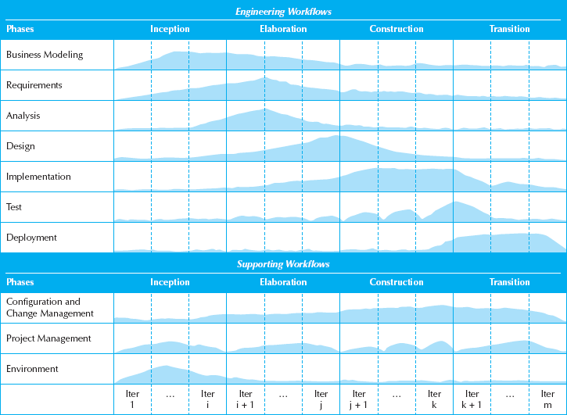
The Unified Process (4 phases, 10 workflows)
Engineering workflow
Supporting workflow

Slide 15
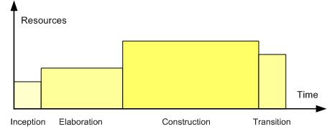
Profile of a typical project showing the relative sizes of the four phases of the Unified Process

Slide 16
Project Team Roles
Role | Responsibilities
Business Analyst | Analyzing the key business aspects of the system Identifying how the system will provide business value Designing the new business processes and policies
Systems Analyst | Identifying how technology can improve business processes Designing the new business processes Designing the information system Ensuring the system conforms to IS standards
Infrastructure Analyst | Ensuring the system conforms to infrastructure standards Identifying infrastructure changes required by the system
Change Management Analyst | Developing and executing a change management plan Developing and executing a user training plan
Project Manager | Managing the team Developing and monitoring the project plan Assigning resources Serving as the primary point of contact for the project

